Slide 1
Pres-Vac Engineering
Pres-Vac Dry Docking Offer
Spare Parts Frame Agreement

Slide 2
Before Dry-Docking
Current Situation
Purchase main items through chandlers
Unsafe O-rings and misc. from other suppliers
Delivery time is an issue
Lack of information
No pictures/pre-inspection of valves
Optimal Situation
Direct 1-stop-shop for all P/V related items
Pictures used to identify critical spares
Realistic amount incl. in dry-dock budget
Updates recommended based on current and upcoming rules & regulations
No delivery time issues

Slide 3
During Dry-Docking
Current Situation
Yard workshop ”overhauls” valves
Destroys seats
O-rings sometimes reused
  Causing leakage = $$$
  Safety issues
  No insurance/warranty from Pres-Vac
Missing items
Uncertain delivery time
Extra cost
Expensive transportation
Optimal Situation
All spares original and in working condition
No missing items
Extra spares available on site
Time spent on valves minimised
Cost reduced
All PV equipment in one box
Stress and headache removed

Slide 4

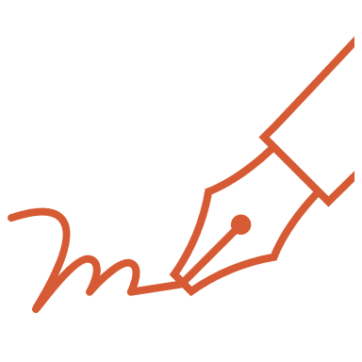

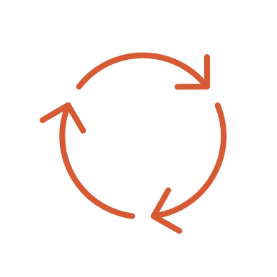
Steps Towards The Optimal Situation
Commitment from both parties
Firm & concrete contract
Trusting relationship
Free flow of information

Slide 5
The Alternative Set-Up
Pictures sent
Condition assessment
Spares package recommended
Owner purchase spares
Spares shipped to yard well ahead of docking
Excess spares returned to Pres-Vac hub
Dry-docking
Credit note to owner

Slide 6
Pros & Cons
PROS PV
Predictable revenue
No cost for overtime
Satisfied customer
PROS MINERVA
Lower prices
Full transparency
No unexpected cost
CONS PV
Lower margins
CONS MINERVA
Liquidity

Slide 7





Pres-Vac’s Offer
PRES-VAC COMMITMENT
TECHNICAL SUPPORT
FAIR & OPEN PRICING
STOCK ALL RELEVANT ITEMS
EXTENDED WARRANTY

Slide 8
Dry-Docking
Current Situation
Pre dry-docking
Purchase main items through directly/agents
Purchase O-rings and misc. from other suppliers
Delivery time is an issue
Lack of information
  No pictures/pre-inspection of valves
During dry-docking
Stressed situation
  Missing items/uncertain delivery time/extra cost
  Expensive transportation
Yard workshop “overhauls” valves
  Destroys seats
  O-rings sometimes reused
Optimal Situation
Pre dry-docking
Direct 1-stop-shop for all P/V related items
Pictures used to identify critical spares
Realistic figure included in dry-dock budget
No delivery time issues / rush
During dry-docking
Stress and headache removed
No missing items
Extra spares available on site
Time spent on venting equipment minimised

