Slide 1
Heco International
We produce piston rod stuffing boxes, designed and developed to keep two-stroke engines running on ships all over the world.
Notes:
While a Heco piston rod stuffing box can seem insignificant, it is key to keep the engines of your ship running.
The unique feature of a slow speed two stroke engine is the sealing between the dirty combustion part and the clean crank case. The heart of this division is the piston rod stuffing box that we produce.

Slide 2
About Heco
Located in Hedensted, Danmark
Heco employs 45 people and 7 robots
Producing more than 180,000 components annually
More than 30,000,000 rings produced since 1959
Processes more than 200 tons of Bronze annually

Slide 3
Our history
2021
G&O Maritime Group
acquired by Polaris
1959
Maskinfabrikken Heco founded by Henning Cornelius in Vejle when inventing the “Heco Ring”
1986-88
Both A/S Vejle Ringe & Magnetfiltre and Maskinfabrikken Heco changed names to Heco International A/S
1977
Companies moved to Hedensted, and the street is named “Hecovej”
2015
Heco International acquired by G&O Maritime Group
1964
First patent on piston rod stuffing boxes
1994
Heco International ISO 9000 certified
1980
Founder Henning Cornelius retired as CEO
1972
Company A/S Vejle Ringe & Magnetfiltre founded
1973
Companies moved to Løsning, 30 employees in total
2003
Heco Mechanical Seals Technology Co. Ltd. established in Suzhou, China

Slide 4
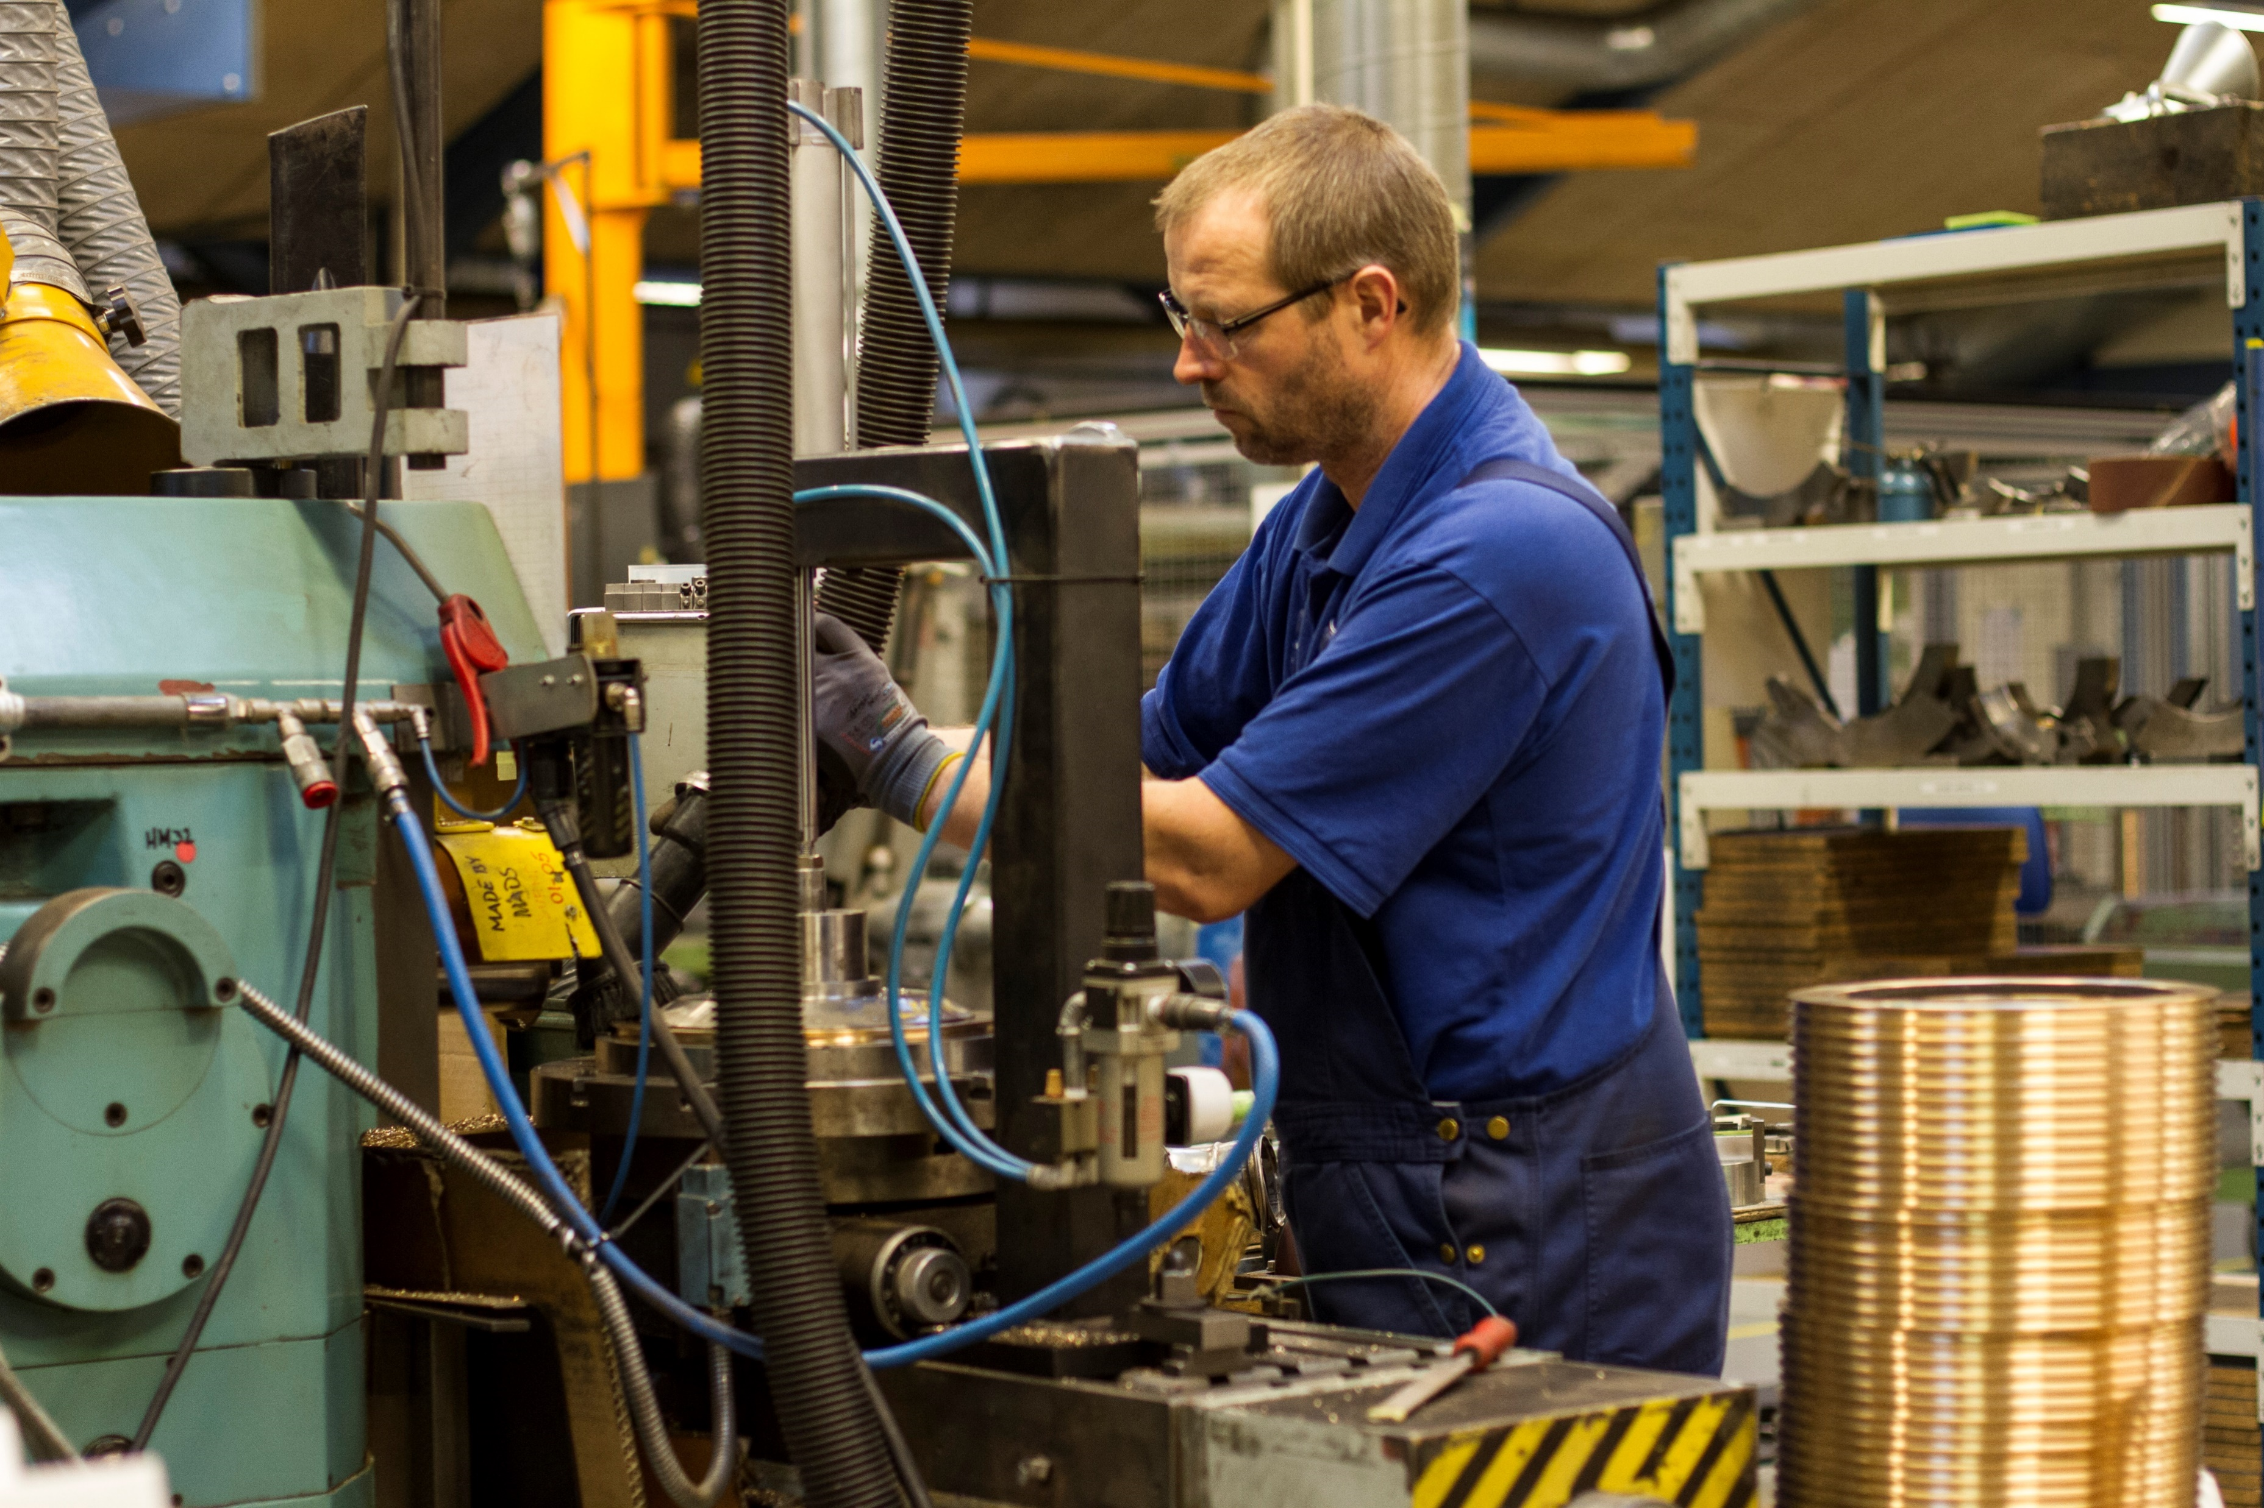
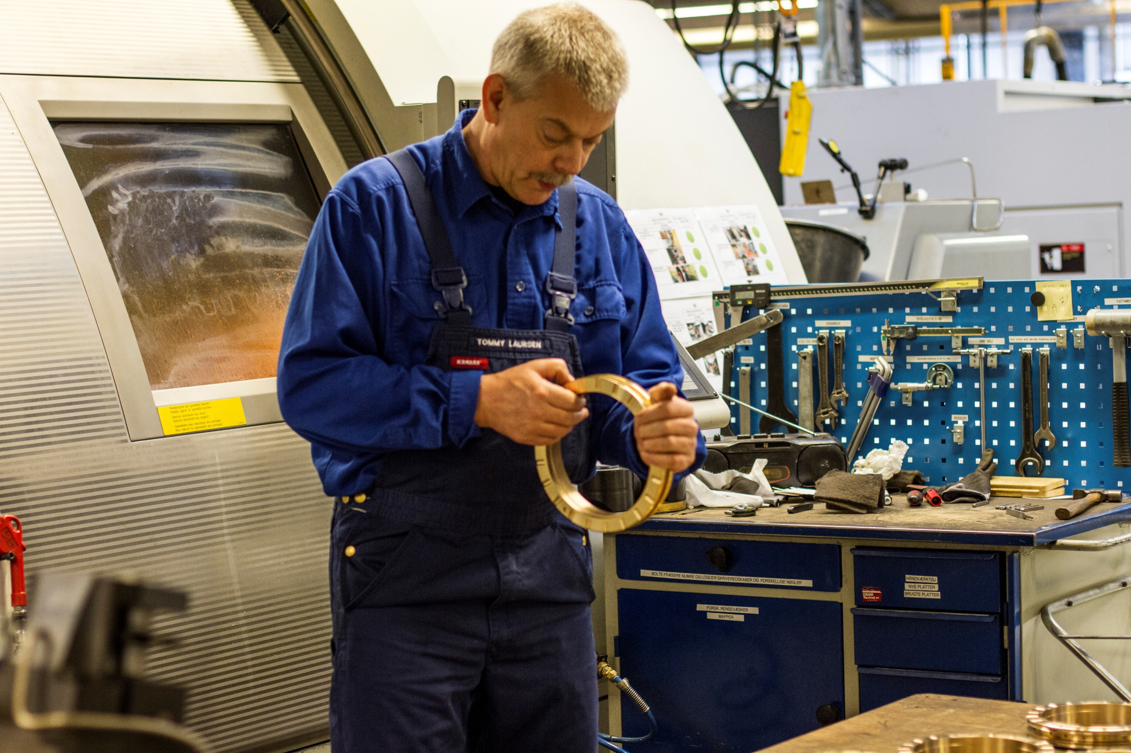
Our Danish Production Site
Meet Keld and Tommy ……
Two of the 45 highly skilled and dedicated employees!

Slide 5
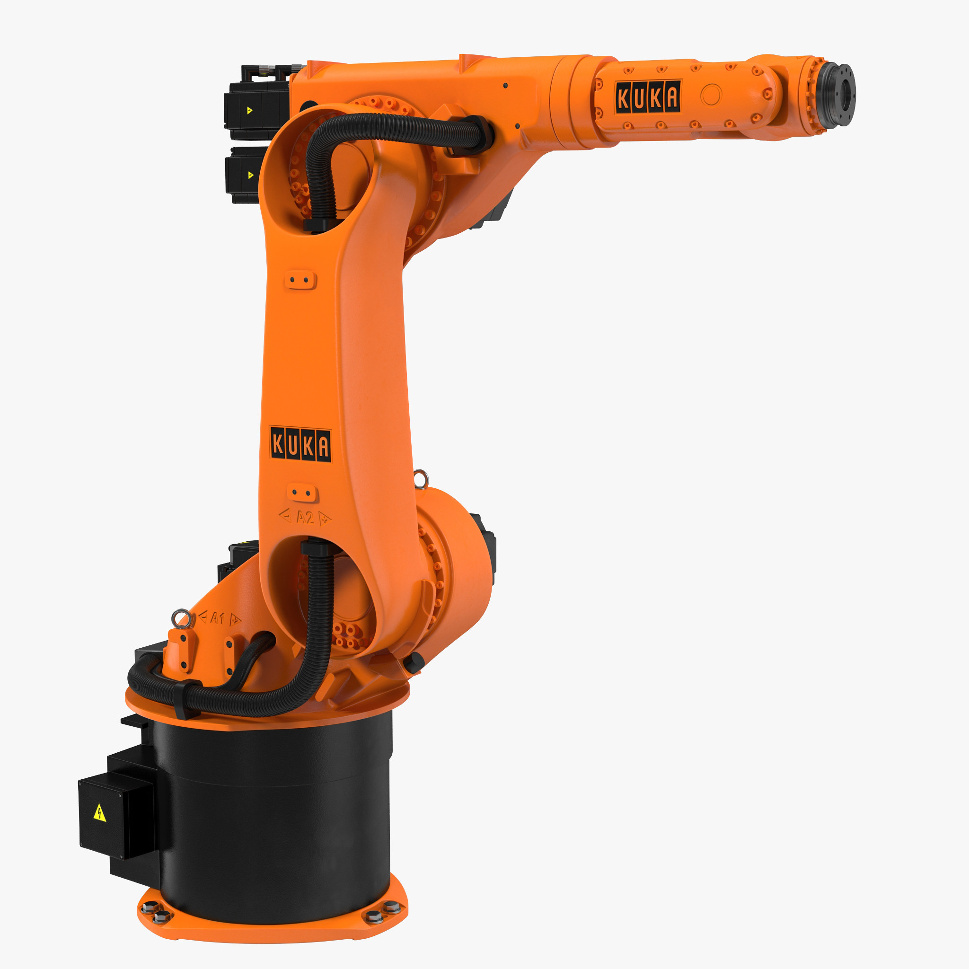
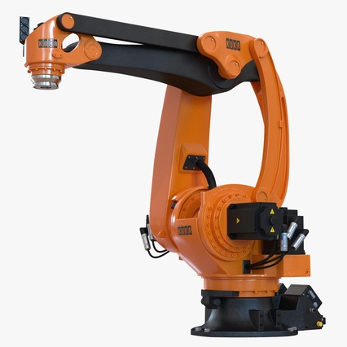
… and not to forget
Roberta and Robert
Two of the seven silent guys that never sleep!

Slide 6
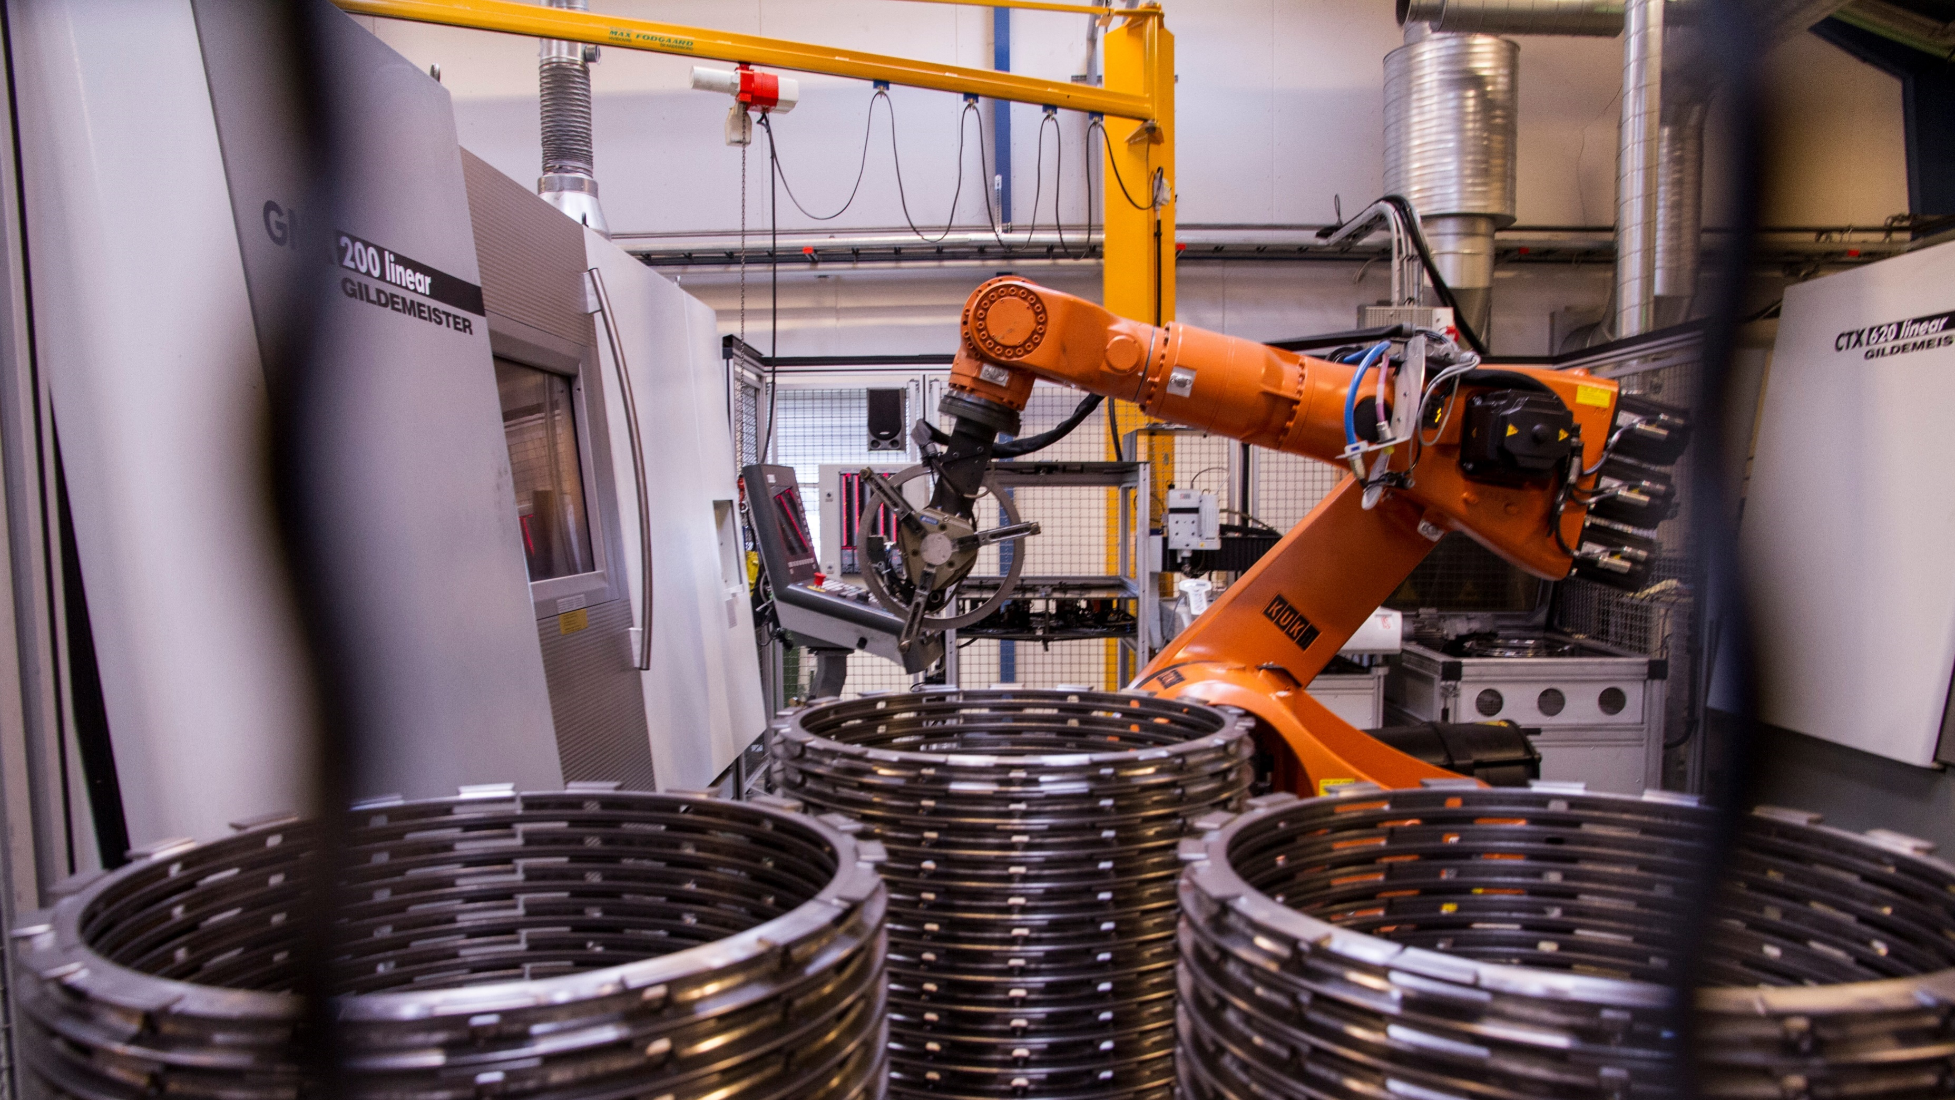


Slide 7
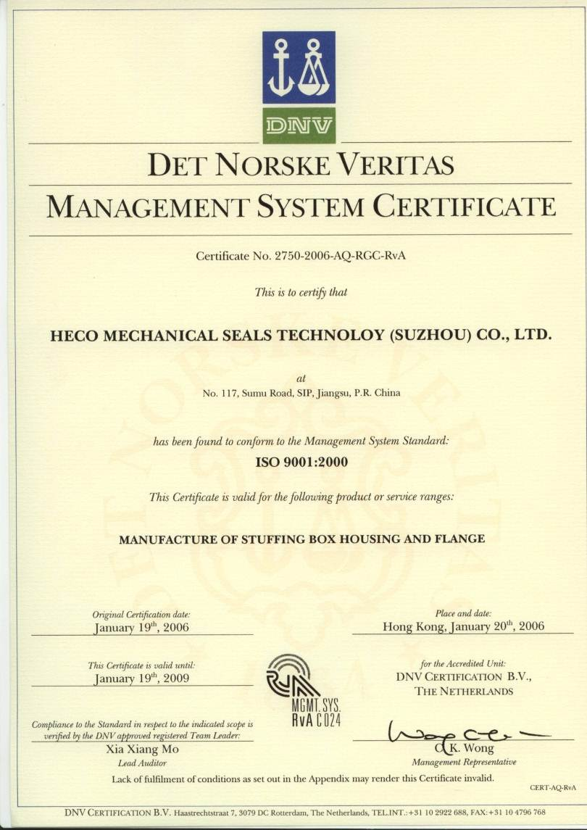
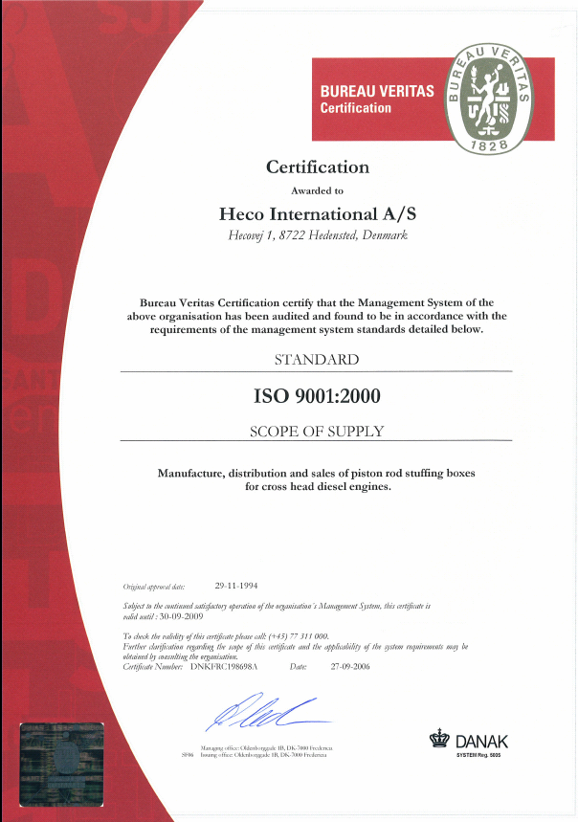
Quality Assurance

Slide 8
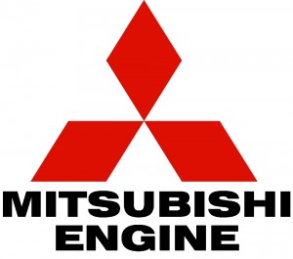

Business Partners

Slide 9
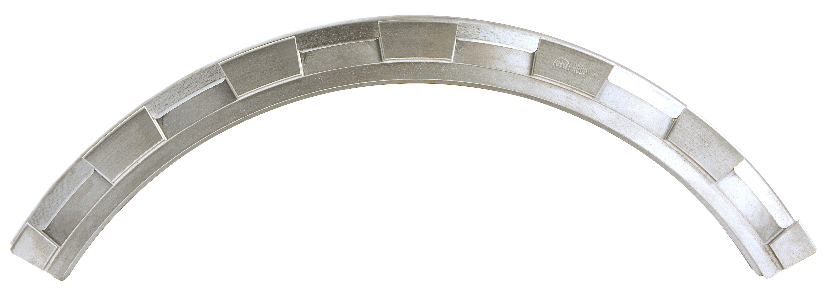


Slide 10
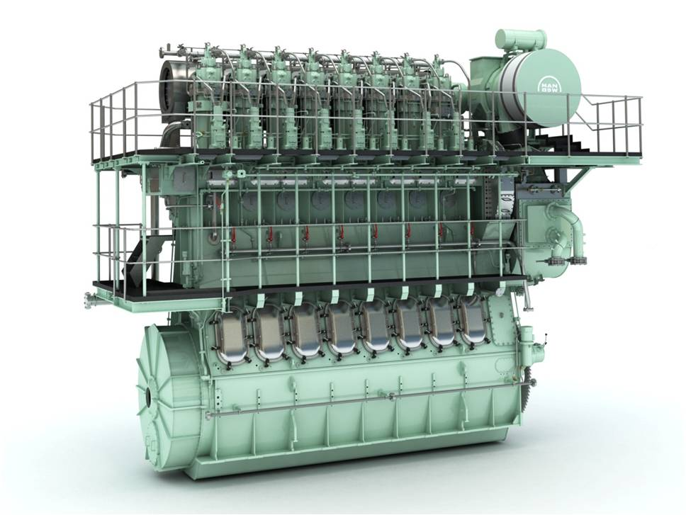

Slide 11
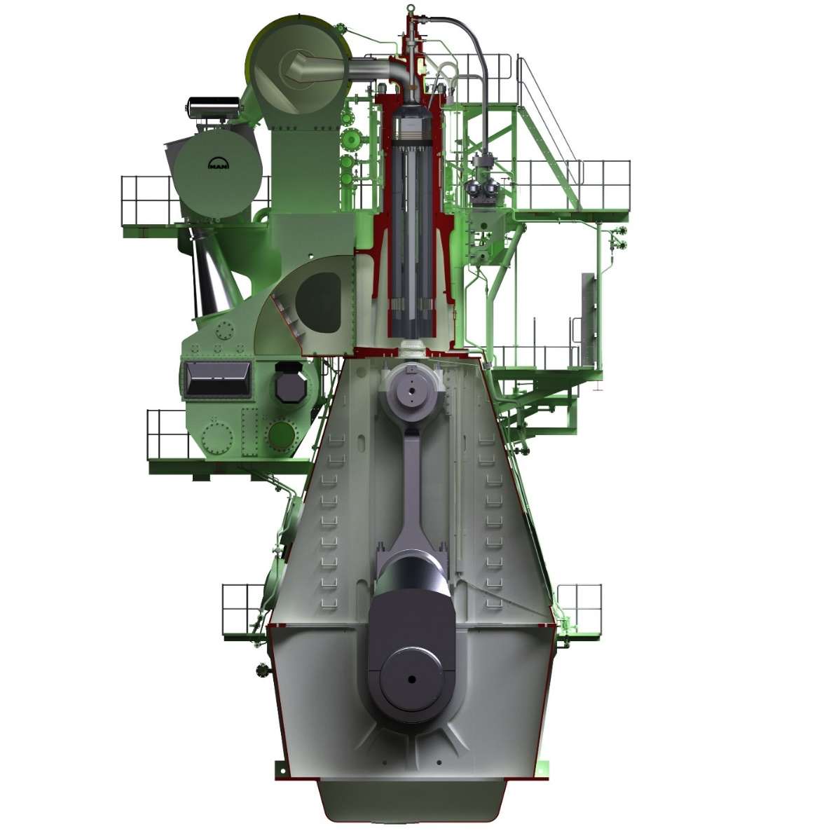

Pressurised scavenging air
Cylinder lubrication oil
Carbon deposits
Combustion section
Crankshaft section
Main Engine lubrication oil

Slide 12
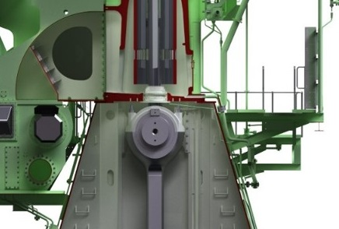

Slide 13
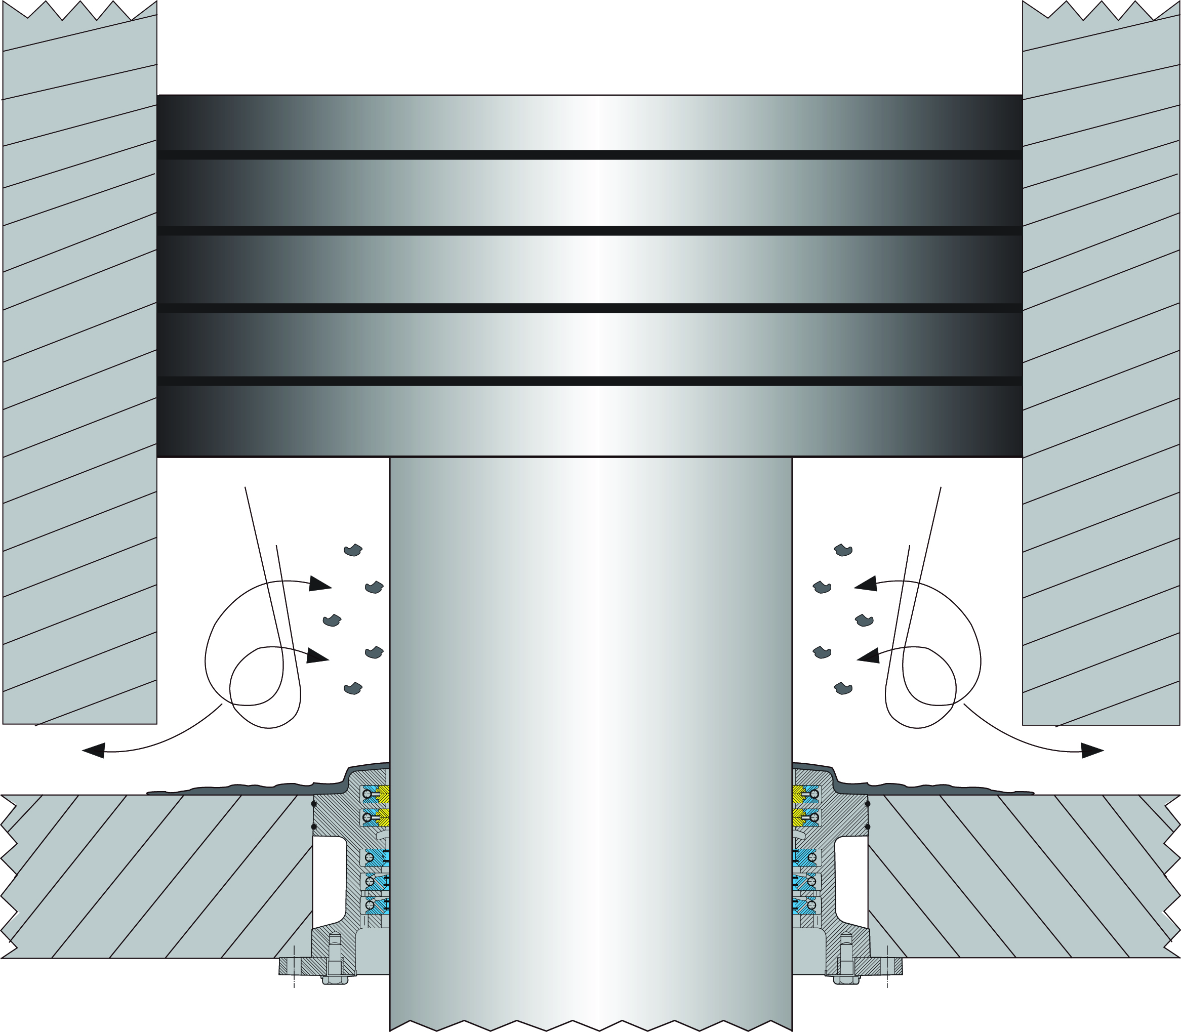
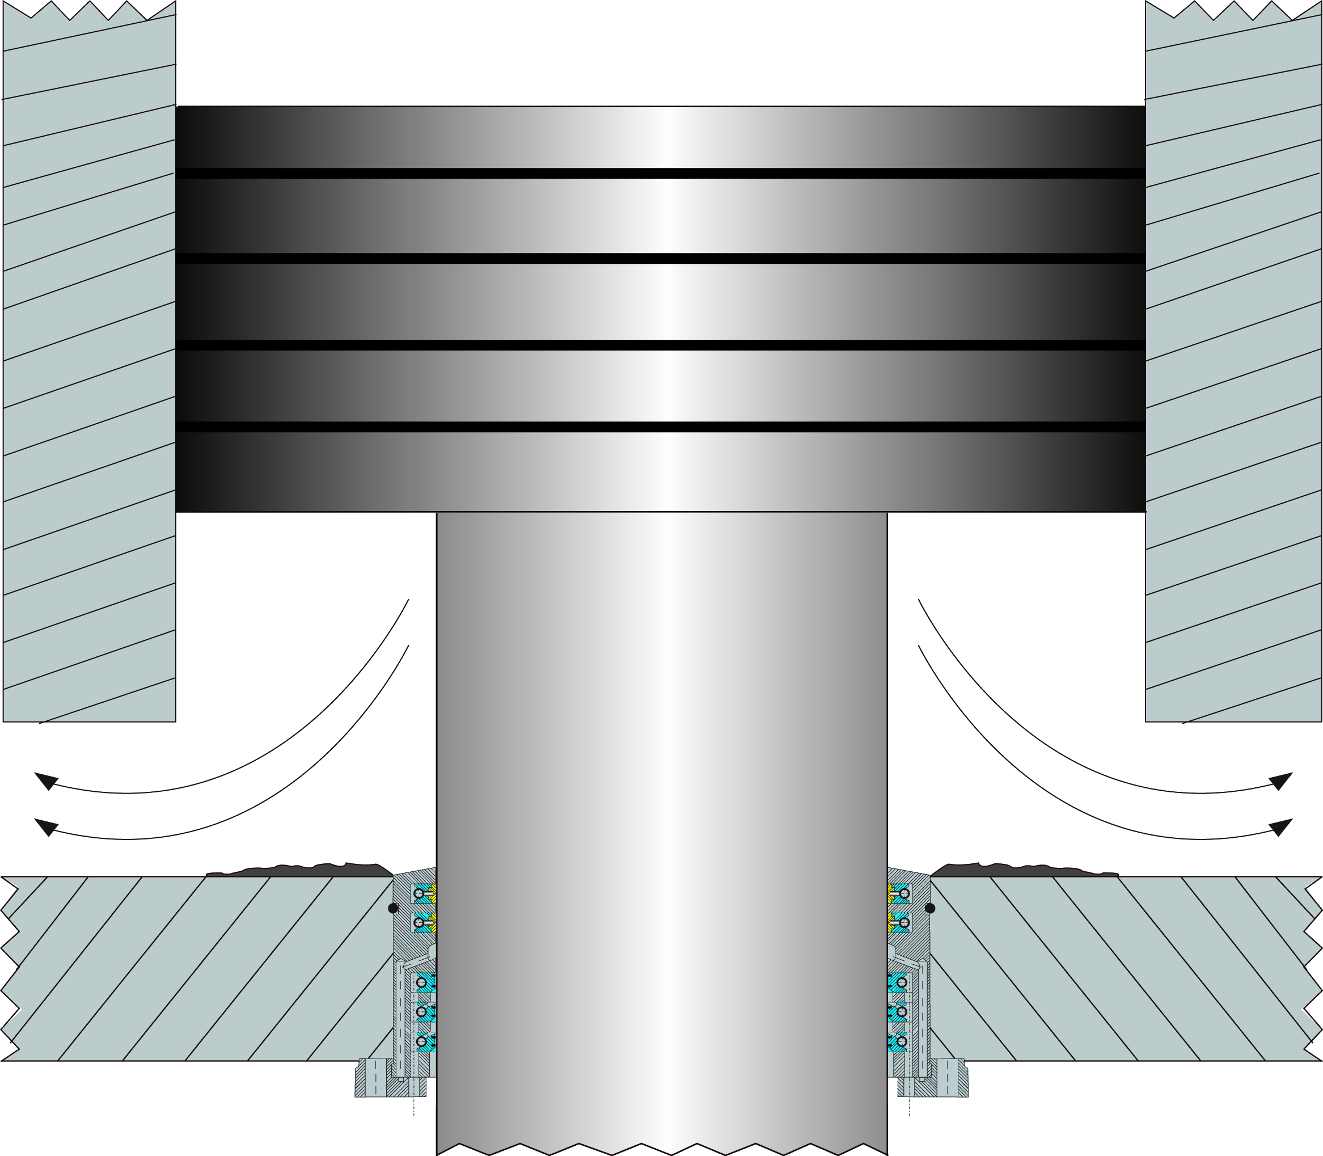

Slide 14
The Piston Rod Stuffing Box
Separates and seals off combustion compartment from the crankshaft compartment

Slide 15
The Piston Rod Stuffing Box
Comprises three main components:
The Housing and Support Ring
The Bronze Rings
The Lamellar Scraper Rings

Slide 16
The Bronze Rings
Scrapes cylinder lubrication oil off the piston rod.
Scrapes carbon residuals and other dirt off the piston rod.
Prevent pressurized scavenging air from leaking into crankshaft compartment.

Slide 17
The Lamella Scraper Rings
Scrapes main engine lubrication oil off the piston rod.
Minimizing the spill of main engine lubrication oil.
Reduces lubrication oil spill to less than 6 litres (cylinder/day).

Slide 19
Optimal engine operation
Our products secure the seal between the dirty combustion part and the clean crank case, which is key to keep your engines running smoothly.
We also prevent impurities from the scavenging air space from entering the crank case housing, which reduces system oil waste significantly and thereby saves cost.
New fuel types are slowly entering the market, and those new fuels come with new requirements for a ship’s engines and stuffing boxes. We are partnering with the world’s largest engine builders to find new solutions that can live up to the changes.

Slide 20
High quality, market leading products
Increase engine lifetime
Products tailored to your need with high precision
Continuous product development adapting to changes in the market

Slide 21



We offer 24/7 professional service
The best way to protect your equipment is to ensure that maintenance and service is done by Heco trained staff only, and that original spare parts are used.
We can help you when contacting us directly or via our partners around the world. We partner with MAN & Wärtsila so you can purchase our products directly via your engine builder.

Slide 22
Contact HECO International
VISITING ADDRESS
Hecovej 1
8722 Hedensted
Denmark
+45 75 89 21 22
heco.gomaritimegroup.com
SALES & SERVICE
heco@heco.dk

