Slide 1
G&O Compensators
It is more complex to operate vessels today than ever before. New technology, increased regulations, new fuel types, crew welfare focus, and much more affects an operation.
All of these factors benefit from reducing vibrations. A G&O compensator will significantly benefit many aspects of your operation.

Slide 2
Our history

Slide 4
Our history
2021
G&O Maritime Group
acquired by Polaris
1945
Company founded
by Haakon Gertsen as agent company
2014
G&O Maritime Group established when Gertsen & Olufsen acquired Atlas Incinerators
1993
Bo Kristensen joined as CEO
1998
Gertsen & Olufsen bought patent on compensator solution developed by Bo Kristensen
2016
G&O Maritime Group moved to Allerød when acquiring Pres-Vac
Gertsen & Olufsen launched new, lighter series of compensators
1962
Bent Olufsen joined the company
1972
Bent Olufsen became a partner in Gertsen & Olufsen
2002
One of the first bacteria-based water treatment plants in the world developed by G&O

Slide 5
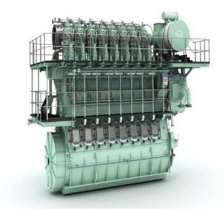
Excitation sources

Slide 6
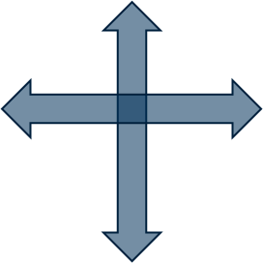
Excitation forces
Guide force moment
(Horizontal)
External unbalanced moment
(Vertical) 2nd order moment

Slide 7
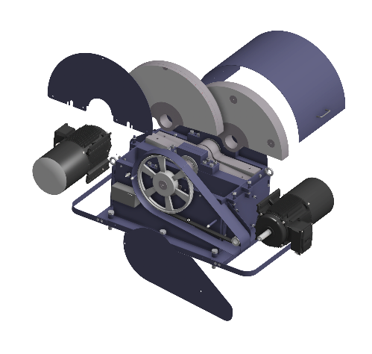
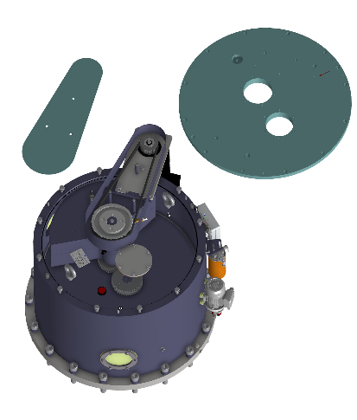
Two types of vibration compensators
Vertical compensator
Counteracts 2nd order external moments
Horizontal compensator
Counteracts guide force H- and X- moments

Slide 8
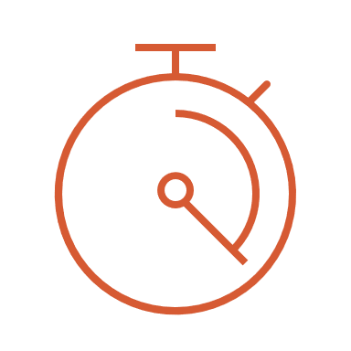
A bit about technology
An exact size
of counterforce
In an exact opposite direction
At an exact timing/phase angle

Slide 9
Simple Product
Two sets counter rotating masses
4 main bearings
Servomotor
Gear wheels
Lube oil pump
Belt drive
Flow Switch
Junction Box
Shafts

Slide 10
Outbalancing Excitation Sources

Slide 11
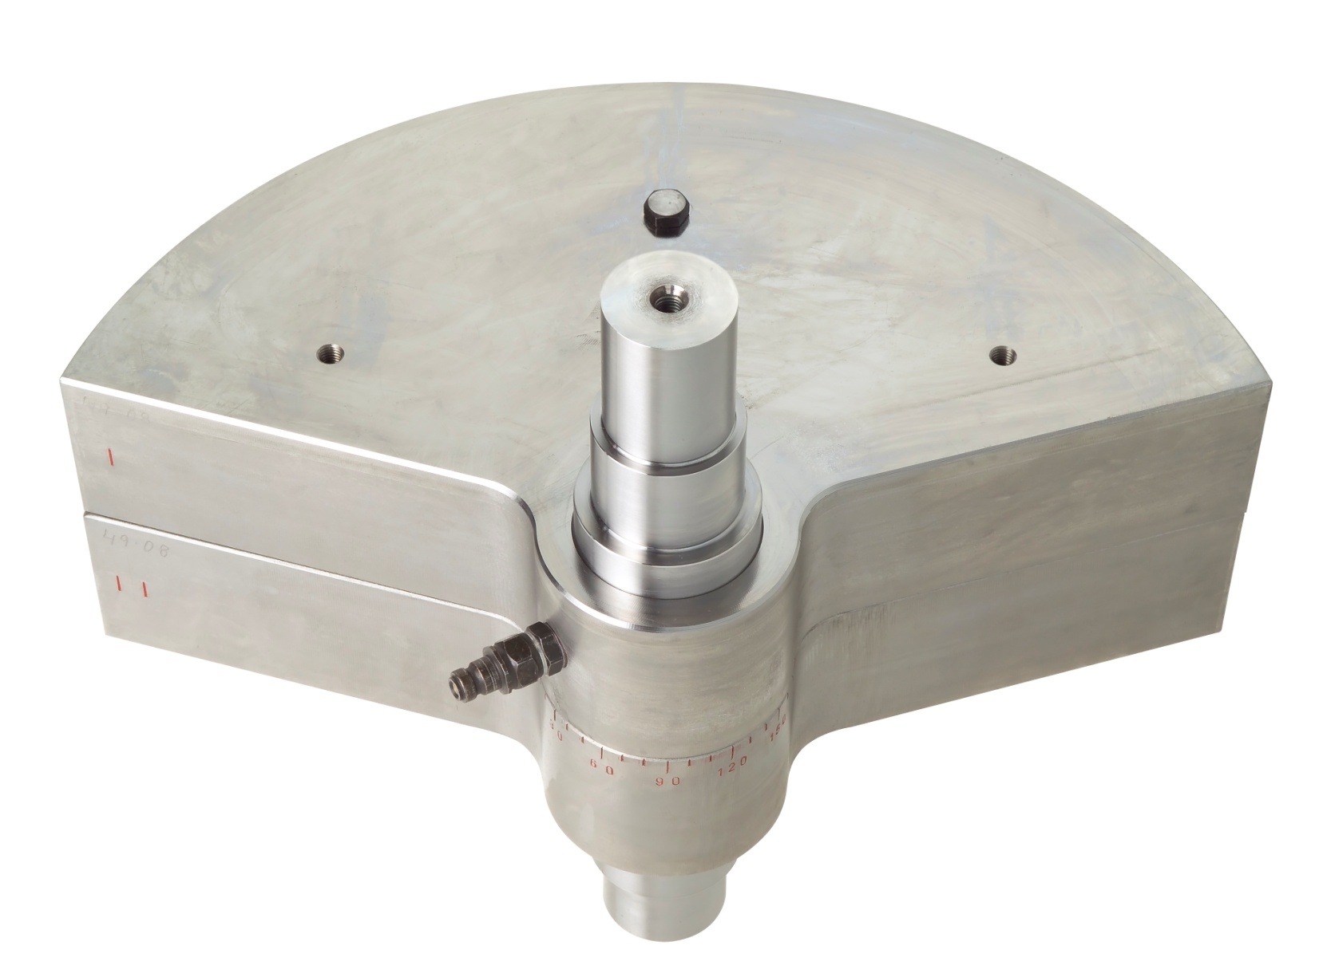
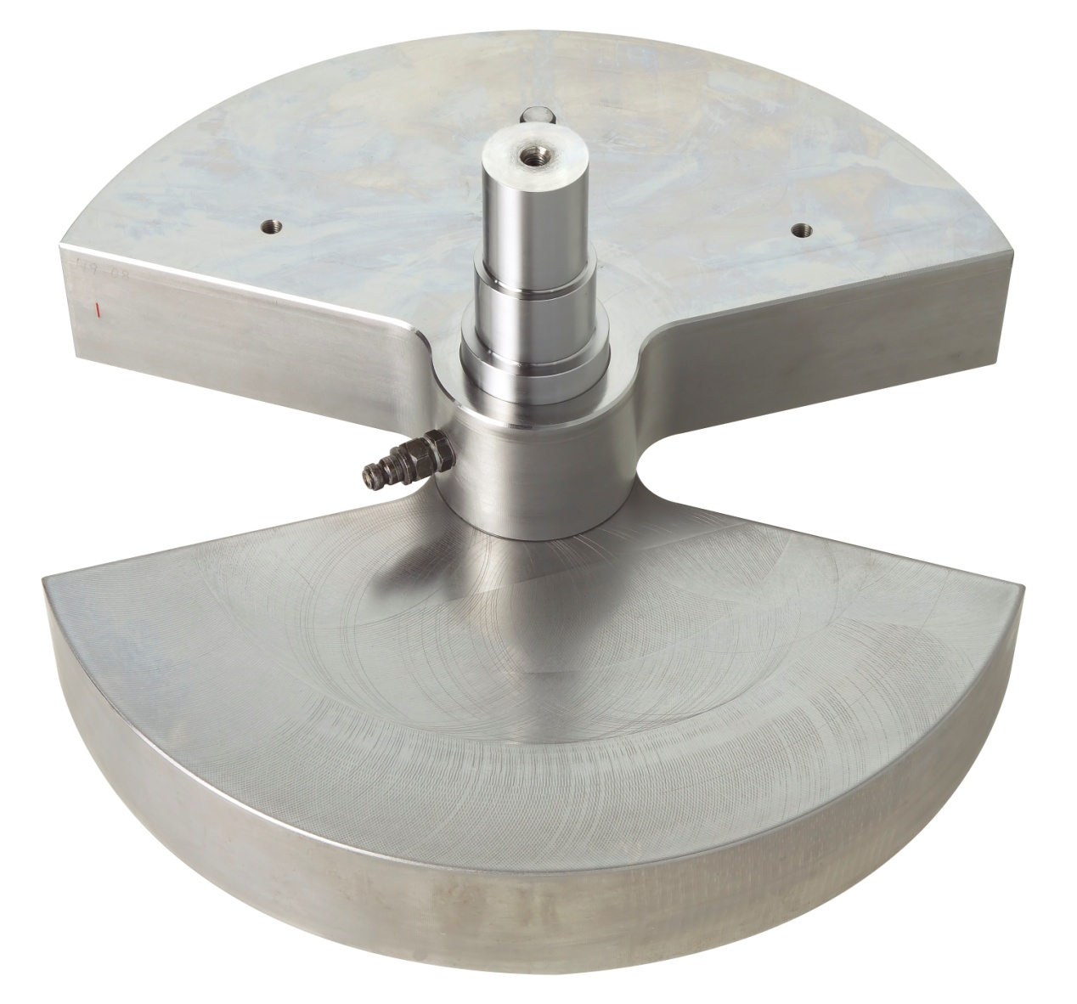

Slide 12
The Vertical Compensator
Counteracts:
Main Engine Induced M2v (2nd Order External Moment)
Placed in the steering gear room
Redundant System
Removes up to 98.7 % of unwanted vibrations
Works 2 x Main Engine Speed
Propeller Induced Vibrations
Placed in the steering gear room directly above propellers
Mirrors the movement of the propeller
Works everytime a blade passes

Slide 13
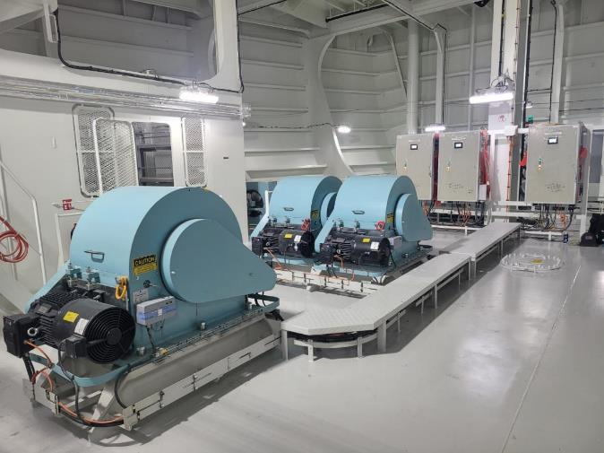
The Vertical Compensators

Slide 14
The Vertical Compensator

Slide 15
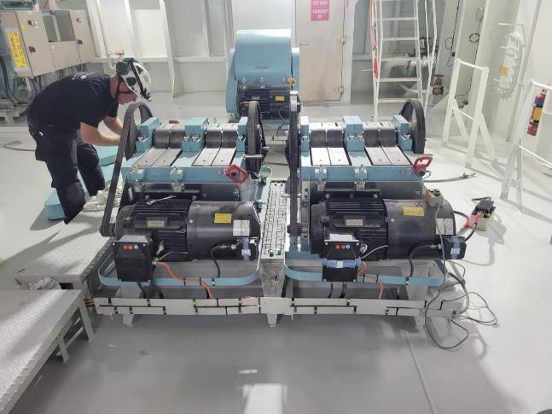
The Vertical Compensator

Slide 16
The Vertical Compensator
ALICANTE KNUTSEN HSHI 8093, Confirmation test, SG room(STBD) Vertical |  |  |  |  |  |  |  |  |  |  |  | 29-06-2022
Main engine |  |  | Measuring condition |  |  |  |  | Compensator setting | Compensator setting | Compensator setting
WinGD W5X72DF |  |  | Draft fore | Draft aft | Beufort | Top bracing |  | Angle V° | Angle V3° | Angle Vc° | Angle Ve° | Imbalance
IMO NO. | 9904194 |  | 10,2 | 8,75 | 3 | on |  | 20 | 90 | 275 | 156,2 | 197kgm

Slide 17
The Horizontal Compensator
Counteracts:
Main Engine Induced Guide Force H- or X-Moments
Placed on the Main Engine
On the M/E Gallery Bracket
For New building- and retro fit projects
Removes up to 98.7 % of unwanted vibrations
Works X-times Main Engine Speed
Depending on the specific guide force moments

Slide 18
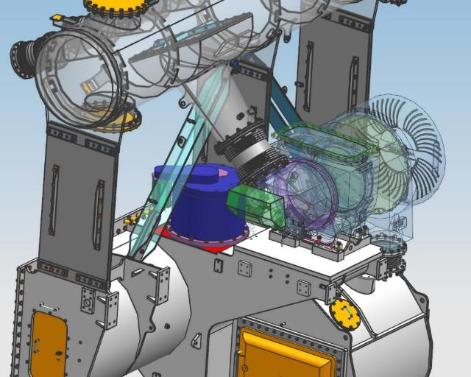
The Horizontal Compensator

Slide 19
The Horizontal Compensator

Slide 20
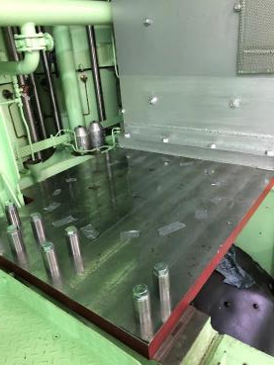
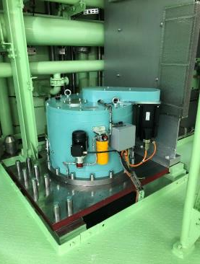
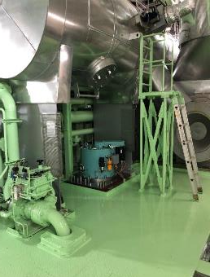
Retrofit Installation

Slide 21
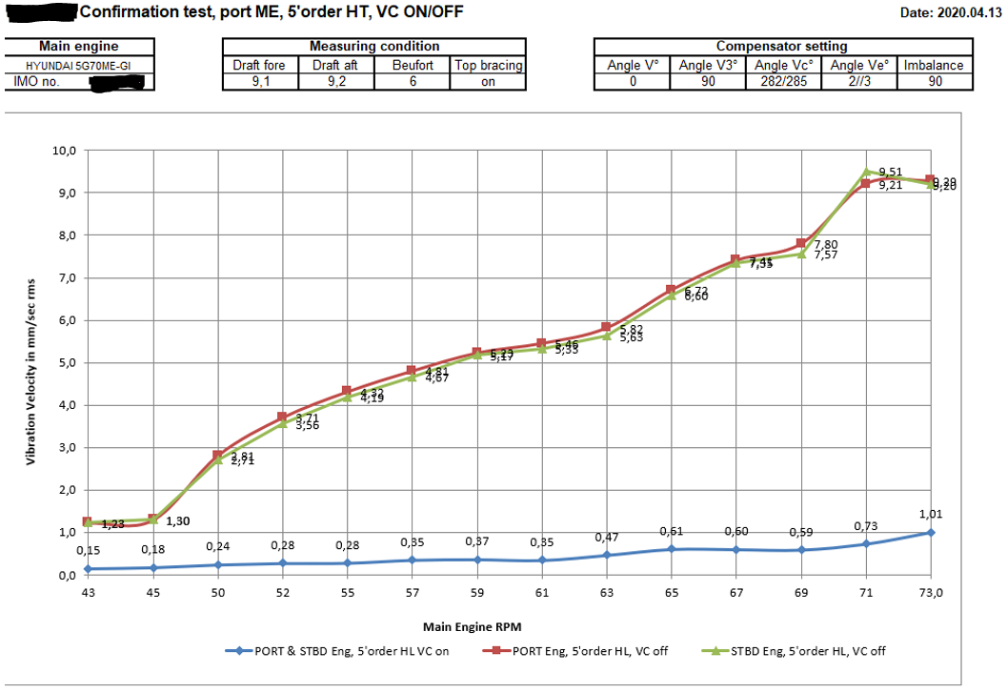
The Horizontal Compensator

Slide 22
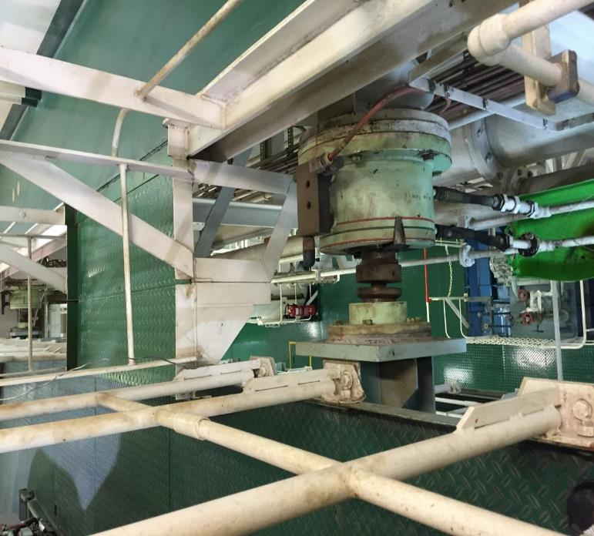
Standard solutions

Slide 23
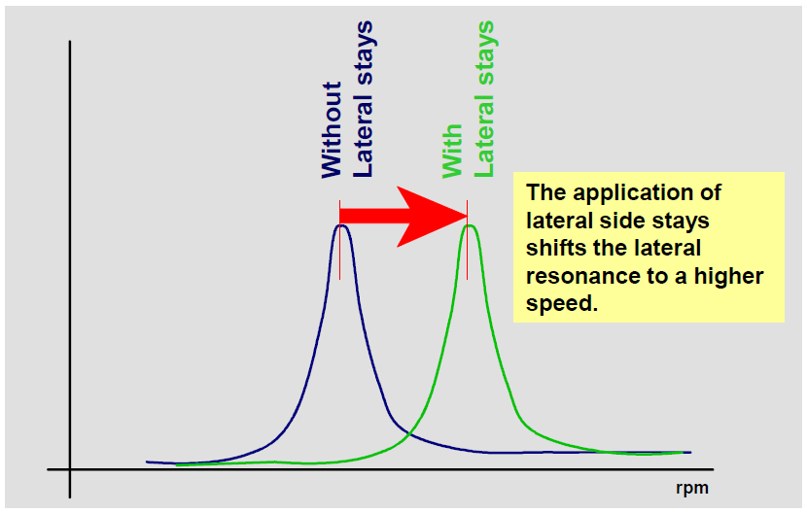
Standard solutions

Slide 24
World Leading Vibration Specialists

Slide 25
CMA CGM Antoine de Saint Exupery
Working Thesis:
Remove M/E induced guide force X-moment
8th Order X-moment
Compensators placed on M/E Gallery Bracket
On 1st and 11th cylinder
Works 8 x M/E speed
Working against each other

Slide 26
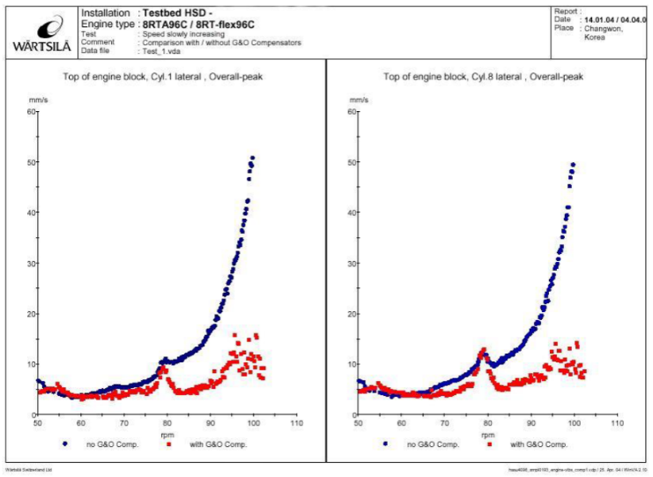
CMA CGM Antoine de Saint Exupery

Slide 27
Contact G&O COMPENSATORS
VISITING ADDRESS
Lundtoftegaardsvej 95, 3
2800 Kgs Lyngby
Denmark
+45 48 17 40 55
gomaritimegroup.com
COMPENSATOR SALES
jun@g-o.dk
SERVICE & SUPPORT
service@g-o.dk

